Slide 1
Automated system to protect the farmland from animals
PRESENTED BY,
PURUSOTHAMAN P
NANDHANA S
VIJAY V
RANJITH S
SSN COLLEGE OF ENGINEERING

Slide 2
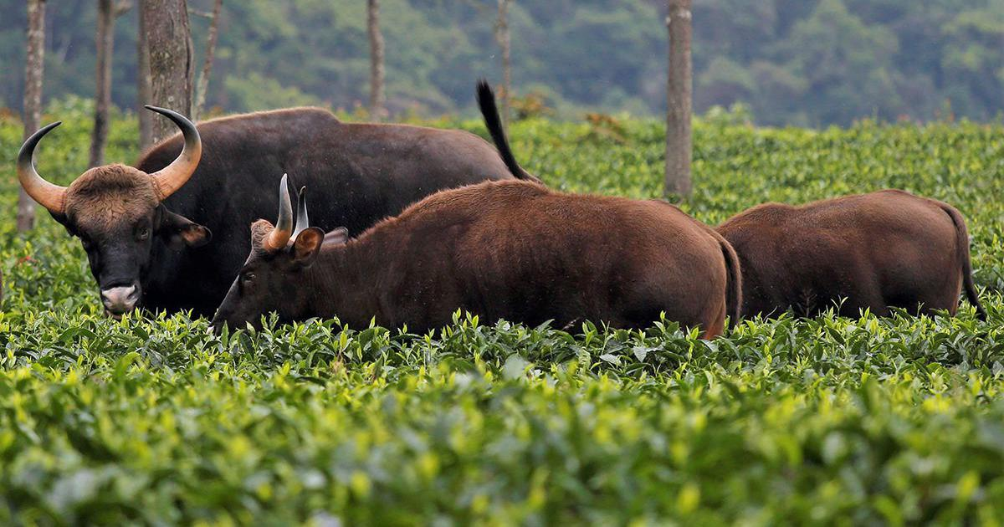
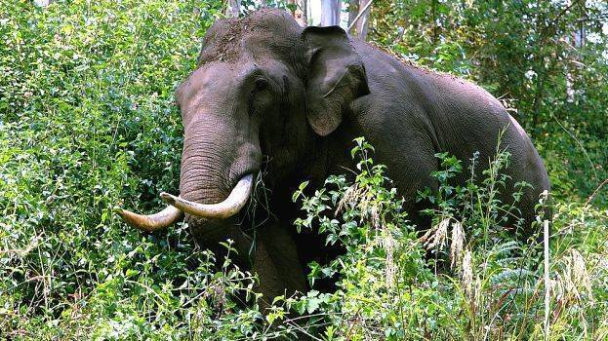
Problem Statement :
Agricultural fields are frequently plagued by the intrusion of animals, leading to crop damage and financial losses for farmers. Traditional methods of animal deterrence, such as fences or scarecrows, are often ineffective or labour-intensive. There is a need for an automated system that can detect animals using thermal camera technology and emit radiation to repel them, providing a cost-effective and efficient solution to protect agricultural yields.

Slide 3
Objectives :
Develop a thermal camera-based detection system capable of accurately identifying animals in agricultural fields.
Design a radiation emission mechanism that effectively deters detected animals without causing harm.
Create an automated control system to integrate detection and emission processes seamlessly.
.

Slide 4
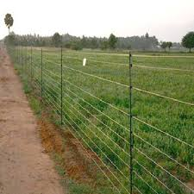
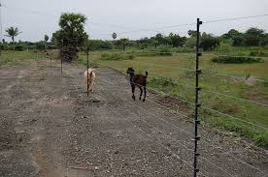
Existing System :
Currently, farmers primarily rely on manual methods or inefficient deterrents such as fences, chemical repellents, or human labour to protect their crops from animal intrusion. These methods are often ineffective, labour-intensive, or environmentally damaging. Some advanced systems utilize motion sensors or sound-based repellents, but these may also have limitations in effectiveness or practicality. There is a clear gap in the market for an automated system that combines thermal imaging technology with non-harmful radiation emission to effectively repel animals from agricultural fields.

Slide 5
Proposed System:
To protect the crops from damage caused by animal as well as to divert the animal without any harm. Animals motion is detected via ultrasonic sensor and identify the animal using Infrared Camera with the help of deep learning algorithm present in the system which is already programmed and trained. Based on the animal it detects, It diverts the animal by producing the Specific frequency radiations through the transducer at different higher frequencies which irritates the animal to evict from the area.

Slide 6
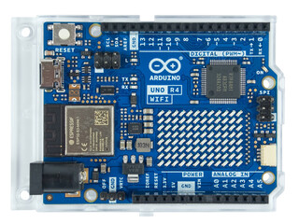
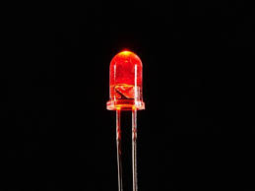
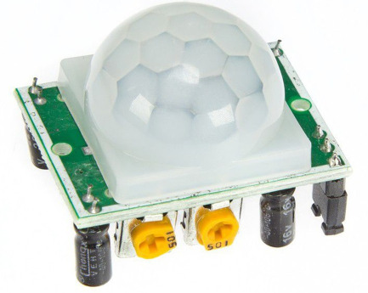
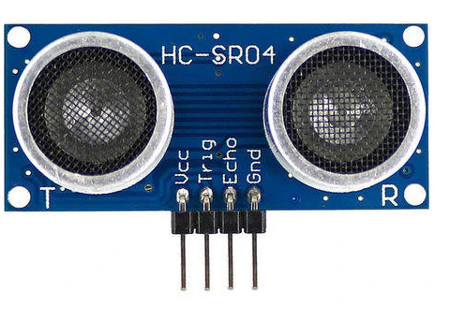
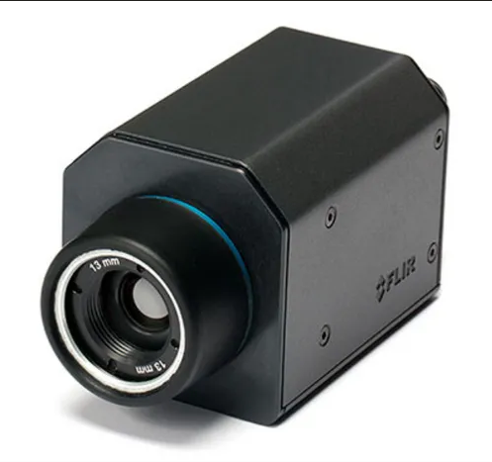
IOT Hardware devices :
Ultrasonic sensor
Thermal Camera
Arduino UNO
LED Pin
PIR sensor

Slide 7


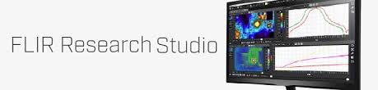
IOT Softwares :
YOLO V7 deep learning software
FLIR Research Studio Software
Arduino PYSerial module

Slide 8
Methodology :
Ultrasonic Sensor and PIR sensor Detection: When an animal enters the farm area, ultrasonic sensors detect its motion and confirms the motion detected using PIR sensor. Ultrasonic sensors emit high-frequency sound waves and measure the time it takes for them to bounce back, allowing them to detect objects or animals in their vicinity.
Activation of Thermal Camera: Upon detecting motion, a thermal camera is activated. Thermal cameras detect infrared radiation emitted by objects or animals, allowing them to create images based on heat signatures. This is useful for identifying animals even in low light conditions.
Animal Recognition with Deep Learning: The thermal camera captures images of the detected animal, and a deep learning algorithm analyses these images to recognize the type of animal present. Deep learning algorithms are trained on large datasets of images to accurately identify objects or animals.

Slide 9
Methodology :
Distance Calculation: Simultaneously, the ultrasonic sensor calculates the distance between the animal and the system. This information is crucial for determining the appropriate response and ensuring the safety of both the system and the animal.
Frequency Release to Deter Animal: Based on the distance calculated and the type of animal recognized, the system releases a specific frequency from a transducer to deter the animal. Certain frequencies can be unpleasant for animals and can effectively discourage them from approaching further into the farm area.

Slide 10
Methodology :
To improve reliability and scalability :
Generate monthly reports highlighting the most frequently trespassed areas in animal intrusion detection.
Include data on the number of human trespassers and animal trespassers.
Database to collect and store data from IoT devices, and send these monthly reports via email.

Slide 11
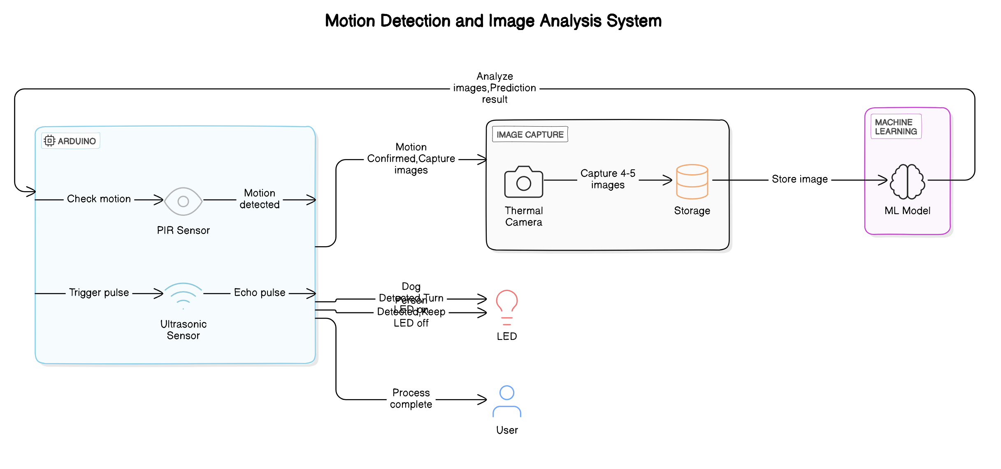
Methodology :

Slide 12
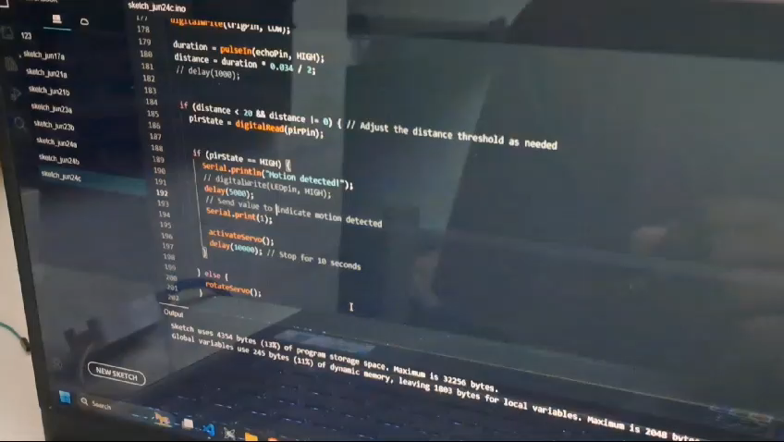
Working Video :

Slide 13
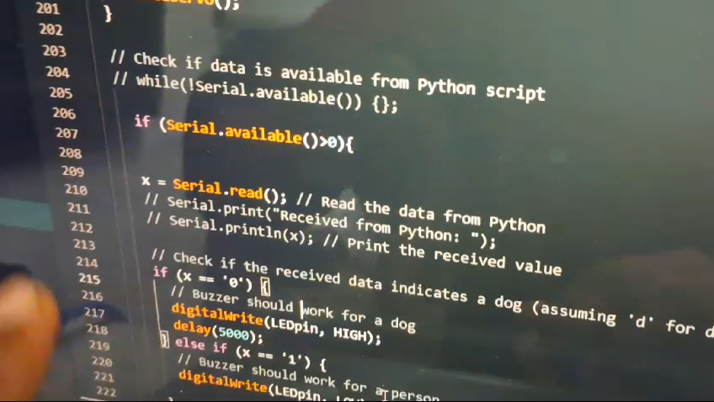
Working Video :

Slide 14
Bottlenecks :
Limited number of available thermal image datasets.
Rare availability of ultrasonic transducers.
Underlying legal issues of handling animals for the project purpose.

Slide 15
Reference :
Hamrick, B., Campbell, T. A., Higginbotham, B., & Lapidge, S. (2011). “ Managing an invasion: effective measures to control wild pigs”.
Bavane, V., Raut, A., Sonune, S., Bawane, A. P., & Jawandhiya, P. M. “Protection of Crops from Wild Animals Using Intelligent Surveillance System”.
Yalden, D. W., & Largen, M. J. (1992). “The endemic mammals of Ethiopia” . Mammal Review, 22(3‐4), 115- 150.R.

Slide 16
THANK YOU

